Slide 1
Indexing Structures for Files

Slide 2
A file already exists with some primary organizations that is hashed or unordered and to describe additional access structures called indexes are used to speed up the retrieval of records. The indexing fields are used to construct the index and basically any field of the file can be used to create an index and multiple index on different fields can be constructed on same file. The types of indexes are based on ordered files and tree data structures. Indexes can also be constructed based on hashing or other data structures.
Types of Single-level Ordered Indexes
Primary Indexes
Clustering Indexes
Secondary Indexes
Multilevel Indexes
Dynamic Multilevel Indexes Using B-Trees and B+-Trees

Slide 3
Indexes as Access Paths
A single-level index is an auxiliary file that makes it more efficient to search for a record in the data file.
The index is usually specified on one field of the file (although it could be specified on several fields)
One form of an index is a file of entries <field value, pointer to record>, which is ordered by field value
The index is called an access path on the field.

Slide 4
Indexes as Access Paths (contd.)
The index file usually occupies considerably less disk blocks than the data file because its entries are much smaller
A binary search on the index yields a pointer to the file record
Indexes can also be characterized as dense or sparse
A dense index has an index entry for every search key value (and hence every record) in the data file.
A sparse (or nondense) index, on the other hand, has index entries for only some of the search values

Slide 5
Indexes as Access Paths (contd.)
Example: Given the following data file EMPLOYEE(NAME, SSN, ADDRESS, JOB, SAL, ... )
Suppose that:
record size R=150 bytes block size B=512 bytes r=30000 records
Then, we get:
blocking factor Bfr= B div R= 512 div 150= 3 records/block
number of file blocks b= (r/Bfr)= (30000/3)= 10000 blocks
For an index on the SSN field, assume the field size V_{SSN}=9 bytes, assume the record pointer size P_{R}=7 bytes. Then:
index entry size R_{I}=(V_{SSN}+ P_{R})=(9+7)=16 bytes
index blocking factor Bfr_{I}= B div R_{I}= 512 div 16= 32 entries/block
number of index blocks b= (r/ Bfr_{I})= (30000/32)= 938 blocks
binary search needs log₂bI= log₂938= 10 block accesses
This is compared to an average linear search cost of:
(b/2)= 30000/2= 15000 block accesses
If the file records are ordered, the binary search cost would be:
log₂b= log₂30000= 15 block accesses

Slide 6
Types of Single-Level Indexes
Primary Index
Defined on an ordered data file
The data file is ordered on a key field
Includes one index entry for each block in the data file; the index entry has the key field value for the first record in the block, which is called the block anchor
A similar scheme can use the last record in a block.
A primary index is a nondense (sparse) index, since it includes an entry for each disk block of the data file and the keys of its anchor record rather than for every search value.

Slide 7
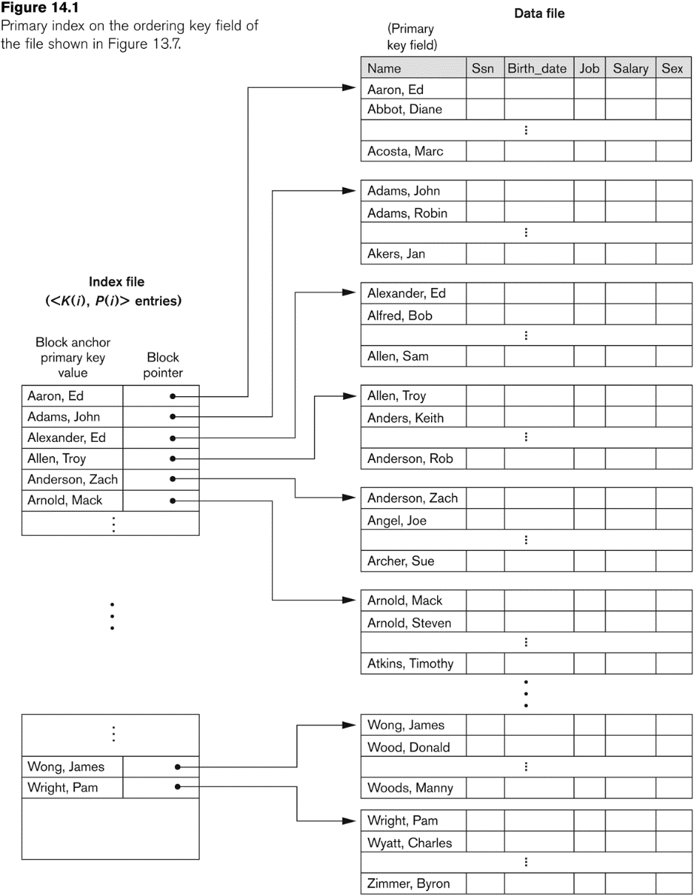
Primary index on the ordering key field

Slide 8
Types of Single-Level Indexes
Clustering Index
Defined on an ordered data file
The data file is ordered on a non-key field unlike primary index, which requires that the ordering field of the data file have a distinct value for each record.
Includes one index entry for each distinct value of the field; the index entry points to the first data block that contains records with that field value.
It is another example of nondense index where Insertion and Deletion is relatively straightforward with a clustering index.

Slide 9
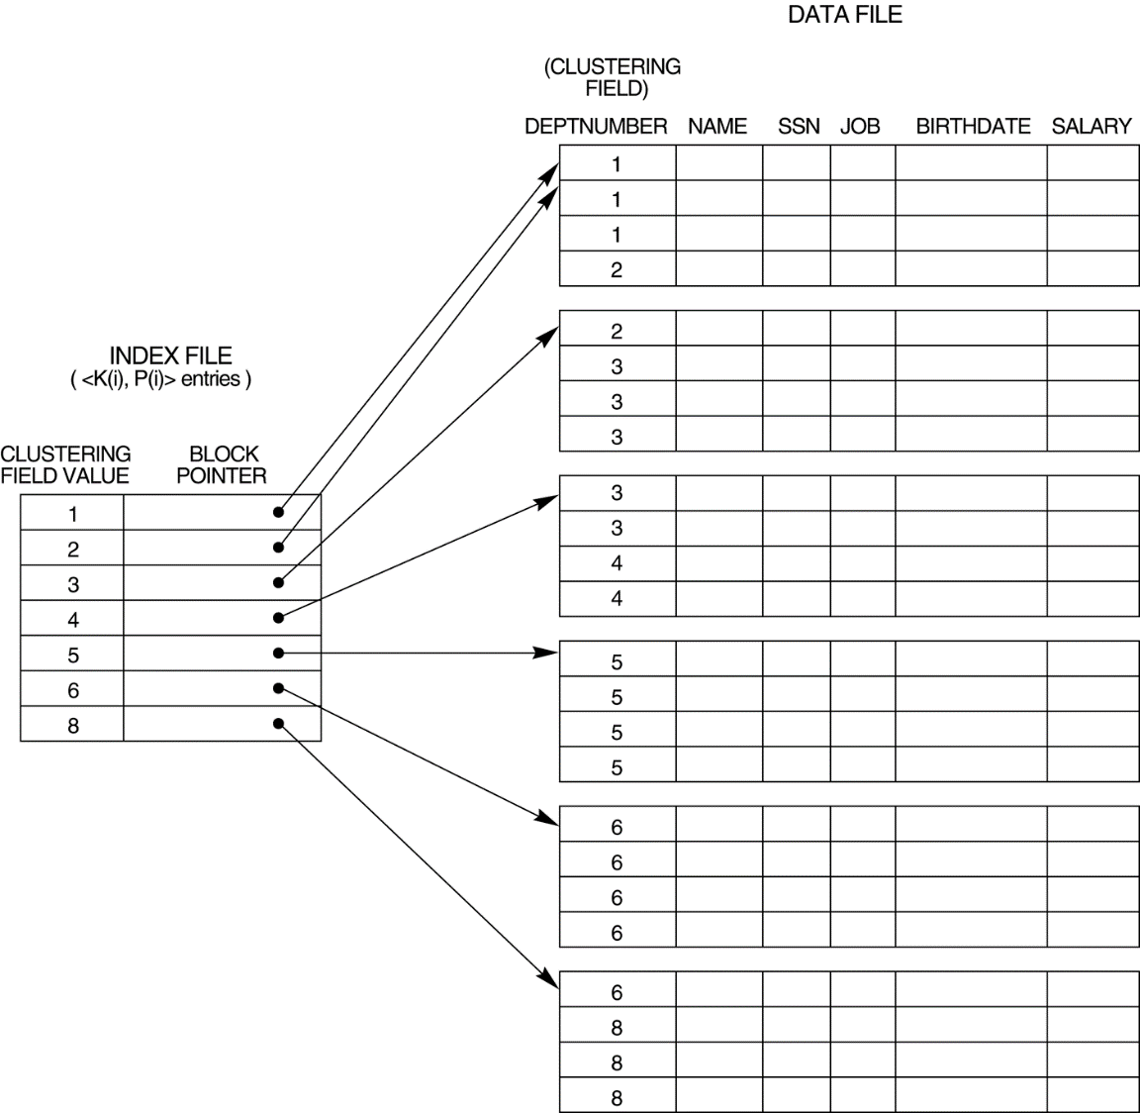
A clustering index on the DEPTNUMBER ordering non-key field of an EMPLOYEE file.

Slide 10
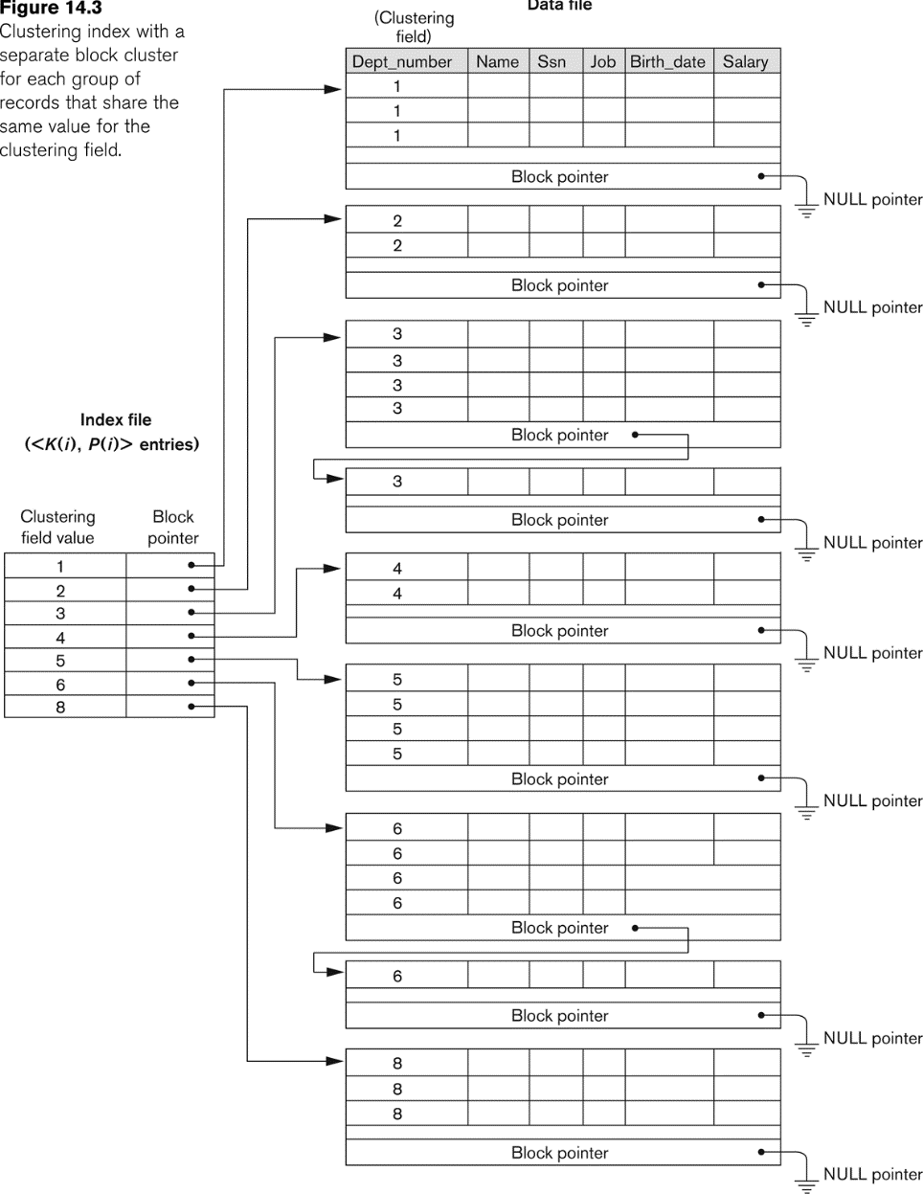
Another Clustering Index Example

Slide 11
Types of Single-Level Indexes
Secondary Index
A secondary index provides a secondary means of accessing a file for which some primary access already exists.
The secondary index may be on a field which is a candidate key and has a unique value in every record, or a non-key with duplicate values.
The index is an ordered file with two fields.
The first field is of the same data type as some non-ordering field of the data file that is an indexing field.
The second field is either a block pointer or a record pointer.
There can be many secondary indexes (and hence, indexing fields) for the same file.
Includes one entry for each record in the data file; hence, it is a dense index

Slide 12
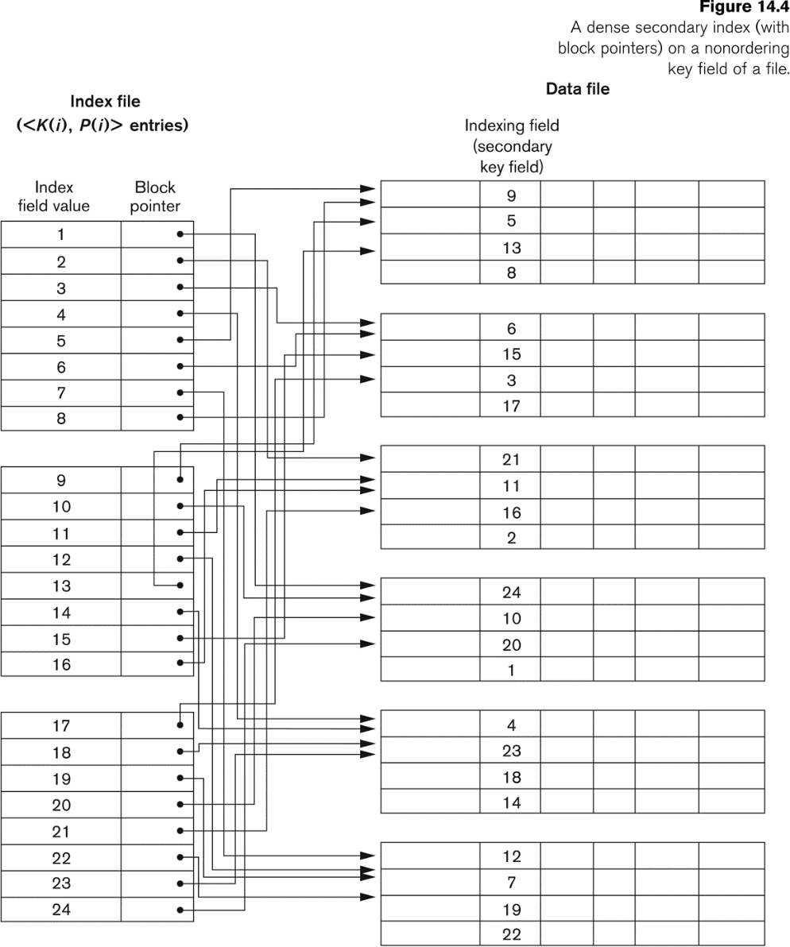
Example of a Dense Secondary Index

Slide 13
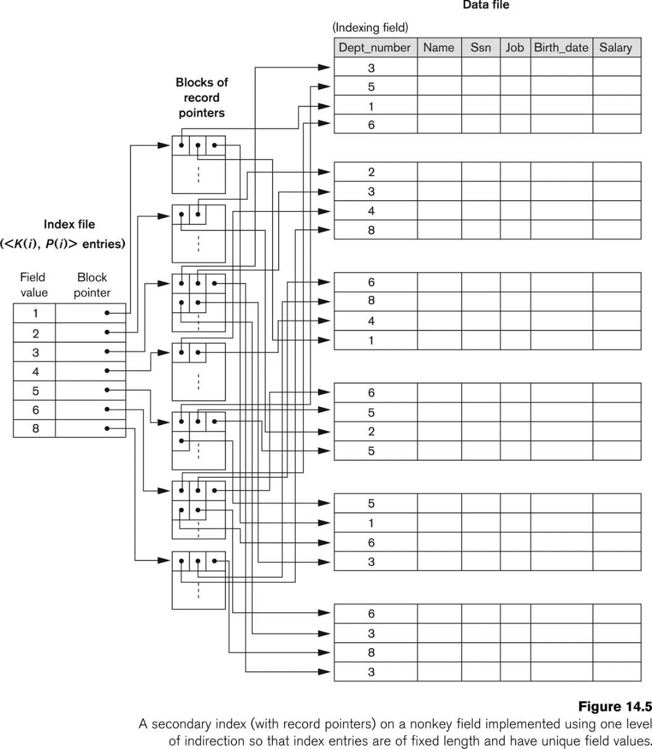
An Example of a Secondary Index

Slide 14
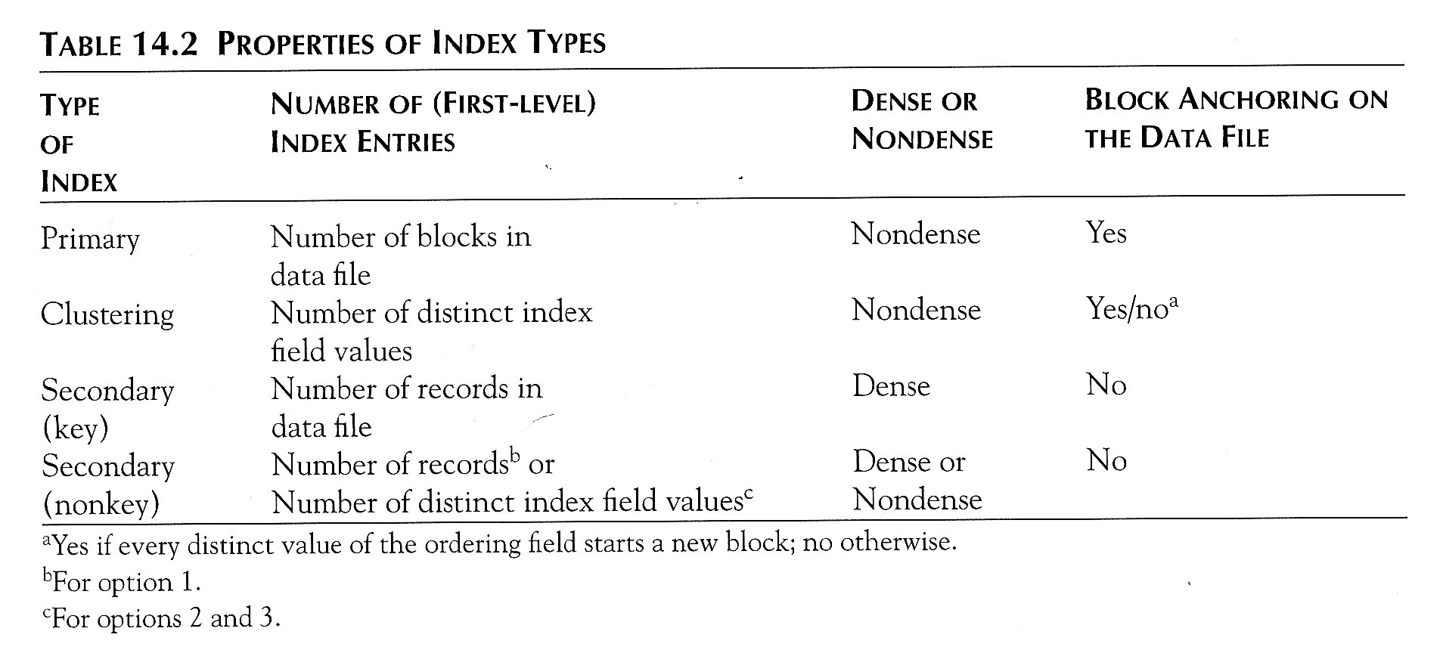
Properties of Index Types

Slide 15
Multi-Level Indexes
The idea behind multilevel index is to reduce the part of index that we continue to search by bfr which is larger than 2 so the search space is reduced much faster.
Because a single-level index is an ordered file, we can create a primary index to the index itself;
In this case, the original index file is called the first-level index and the index to the index is called the second-level index.
We can repeat the process, creating a third, fourth, ..., top level until all entries of the top level fit in one disk block
A multi-level index can be created for any type of first-level index (primary, secondary, clustering) as long as the first-level index consists of more than one disk block

Slide 16
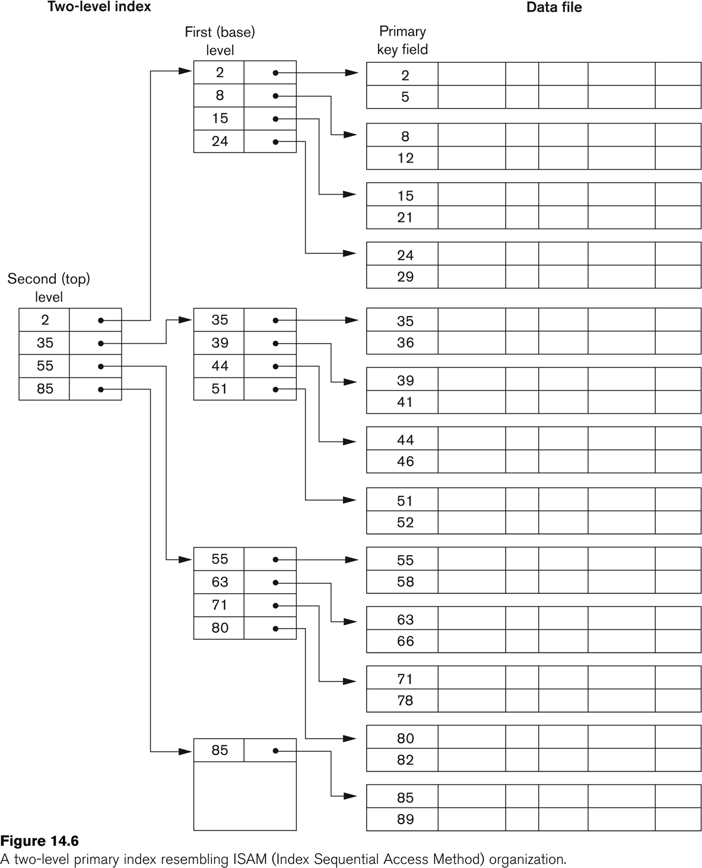
A Two-level Primary Index

Slide 17
Multi-Level Indexes
Such a multi-level index is a form of search tree
However, insertion and deletion of new index entries is a severe problem because every level of the index is an ordered file.

Slide 18
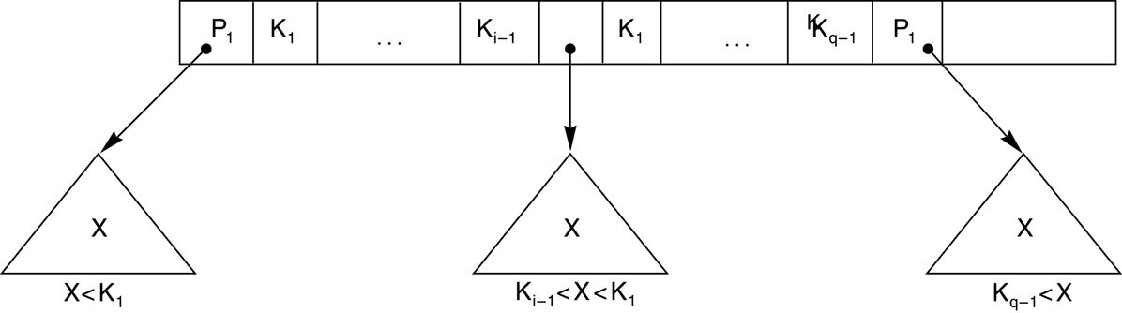
A Node in a Search Tree with Pointers to Subtrees below It

Slide 19
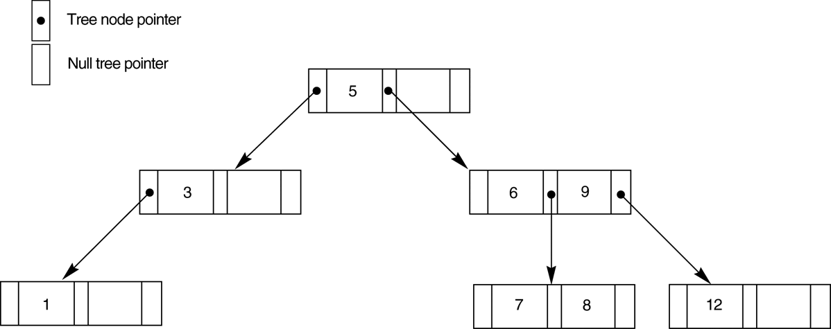
A search tree of order p = 3.

Slide 20
Dynamic Multilevel Indexes Using B-Trees and B+-Trees
Most multi-level indexes use B-tree or B+-tree data structures because of the insertion and deletion problem
This leaves space in each tree node (disk block) to allow for new index entries
These data structures are variations of search trees that allow efficient insertion and deletion of new search values.
In B-Tree and B+-Tree data structures, each node corresponds to a disk block
Each node is kept between half-full and completely full

Slide 21
Dynamic Multilevel Indexes Using B-Trees and B+-Trees (contd.)
An insertion into a node that is not full is quite efficient
If a node is full the insertion causes a split into two nodes
Splitting may propagate to other tree levels
A deletion is quite efficient if a node does not become less than half full
If a deletion causes a node to become less than half full, it must be merged with neighboring nodes

Slide 22
Difference between B-tree and B+-tree
In a B-tree, pointers to data records exist at all levels of the tree
In a B+-tree, all pointers to data records exists at the leaf-level nodes
A B+-tree can have less levels (or higher capacity of search values) than the corresponding B-tree

Slide 23
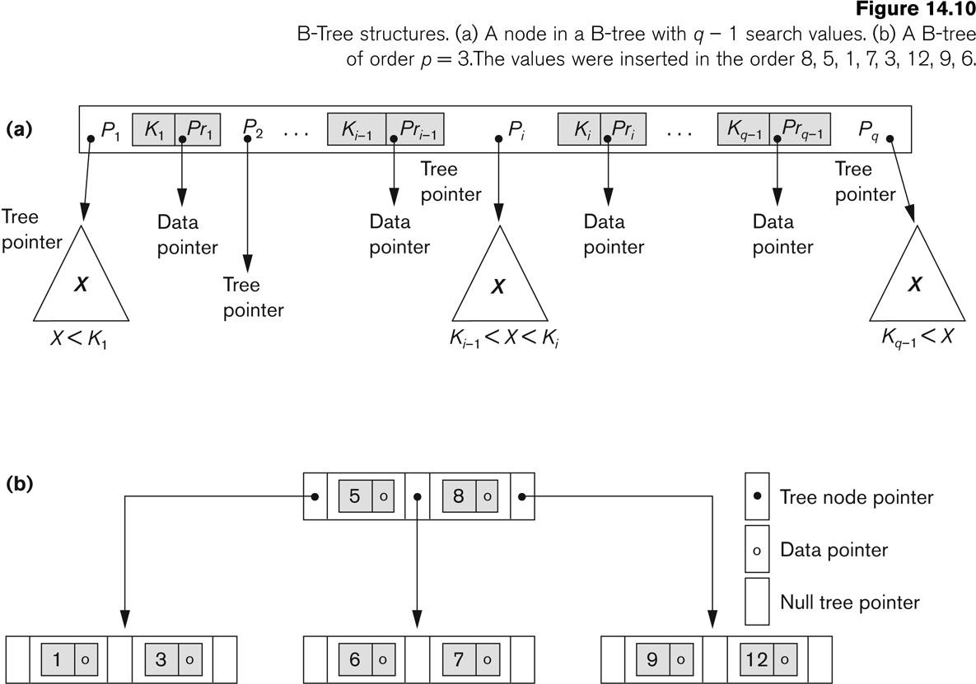
B-tree Structures

Slide 24
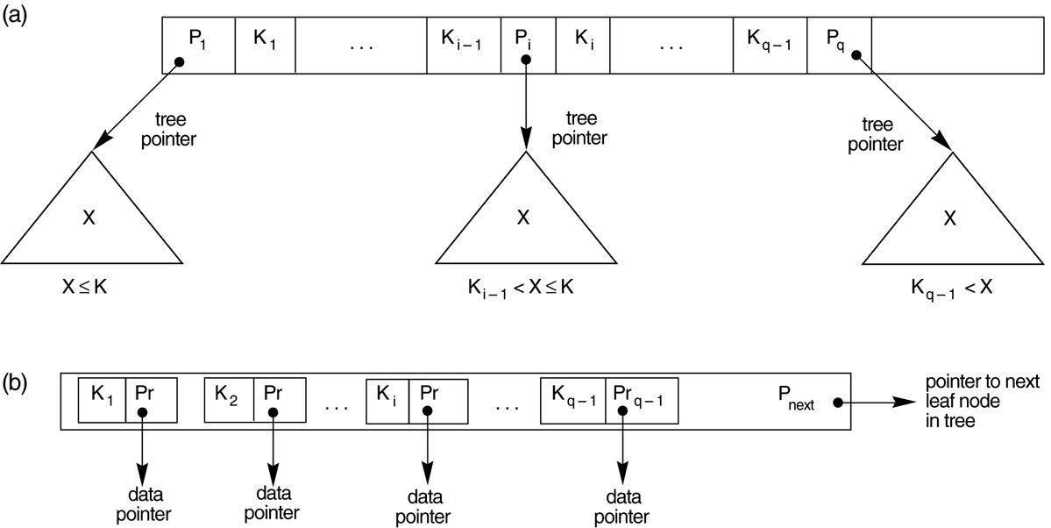
The Nodes of a B+-tree
The nodes of a B+-tree
(a) Internal node of a B+-tree with q –1 search values.
(b) Leaf node of a B+-tree with q – 1 search values and q – 1 data pointers.

Slide 25
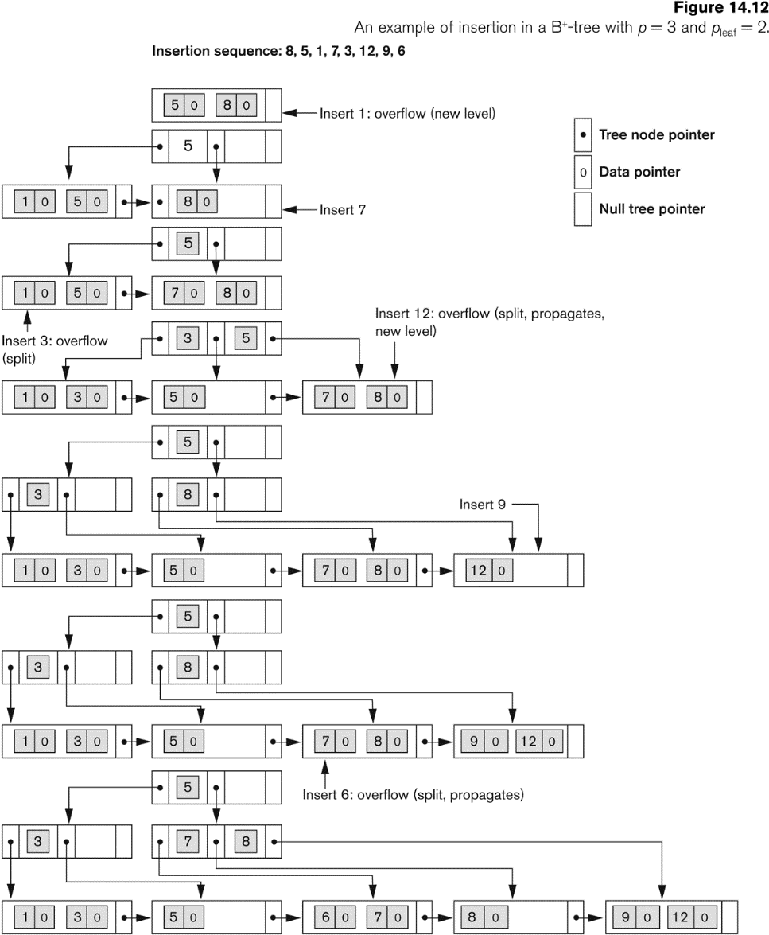
An Example of an Insertion in a B+-tree

Slide 26
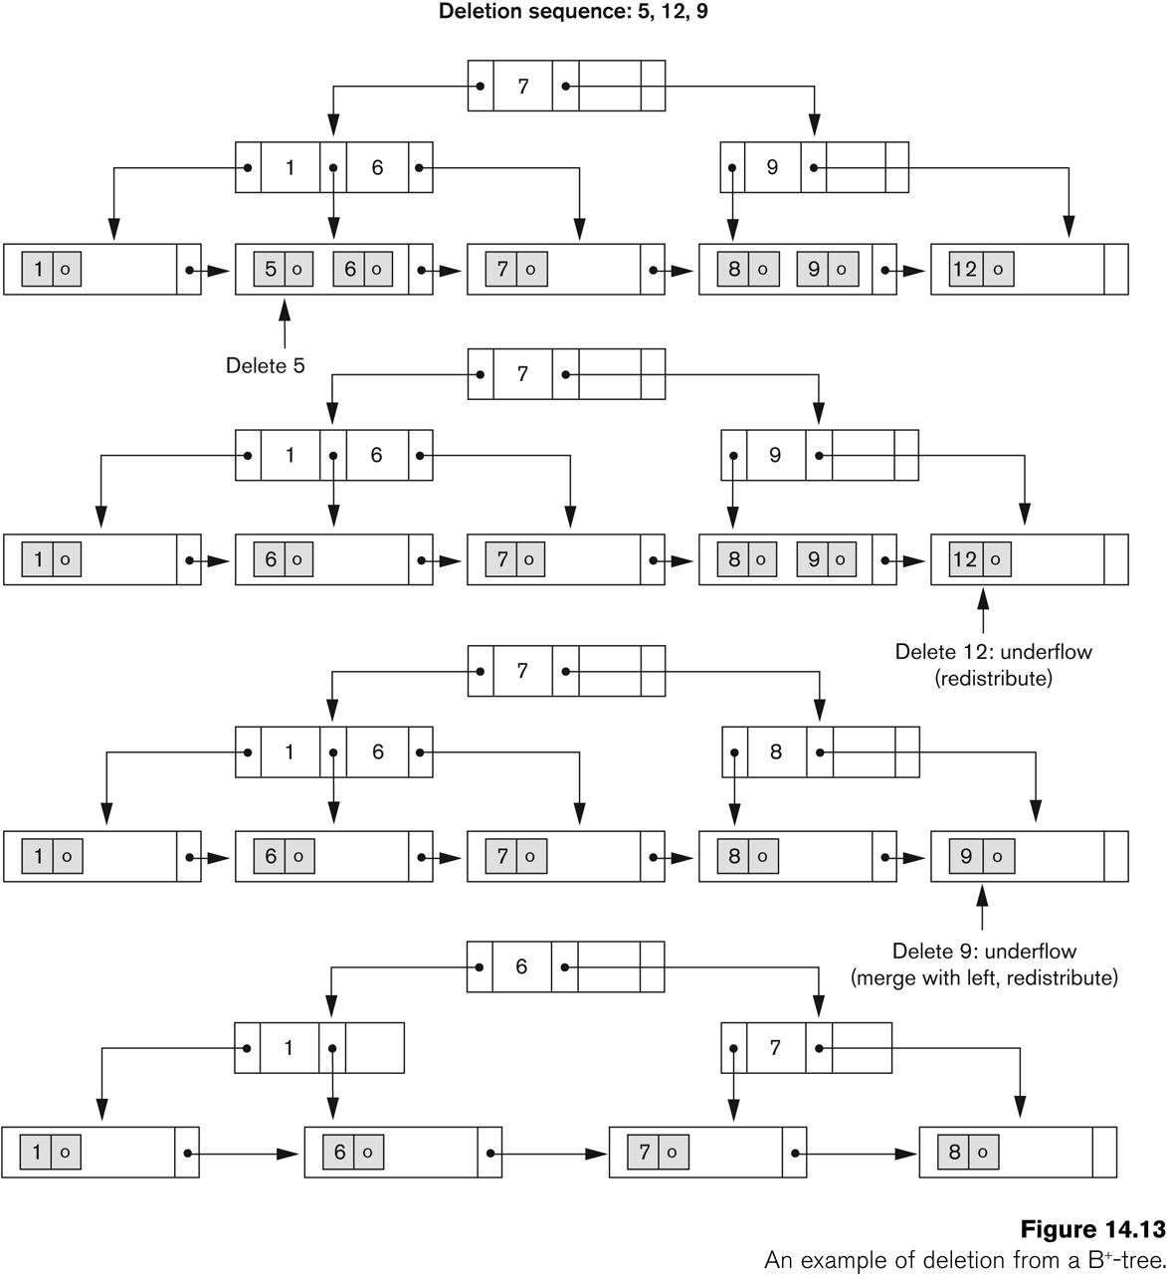
An Example of a Deletion in a B+-tree

